Slide 1

Shotmaniacs Group 1
Beau Jonkhout, Pavan Awadhpersad, Baris Yilmaz, Raphael Ritz, Alex Culda, Raluca Gavrila

Slide 2
Logistics
Planning
Design
Security
Testing
Progress

Slide 3
Logistics.

Slide 4
Roles
Back-end
Raphael & Beau
Front-end
Alex, Raluca & Pavan
Database
Beau & Baris

Slide 5
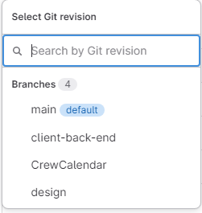
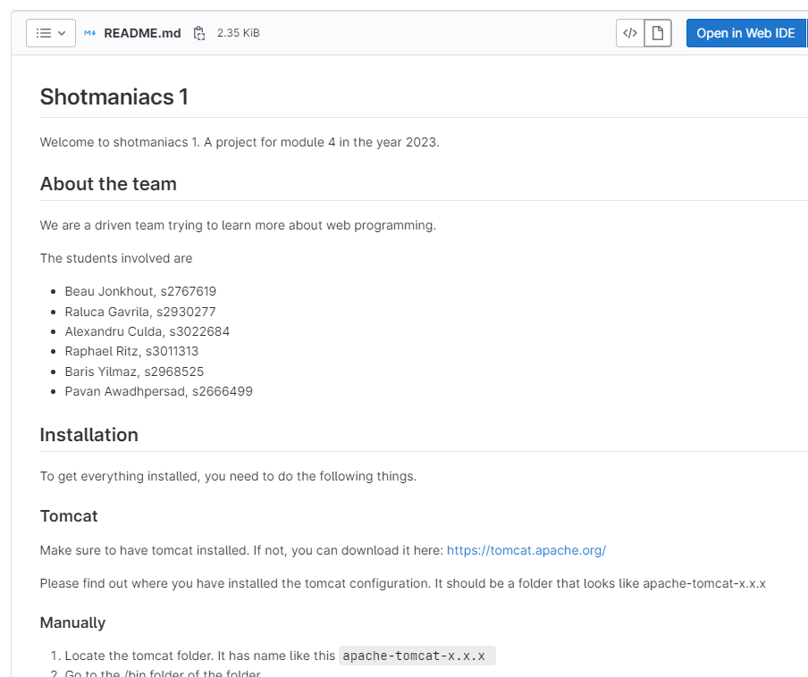
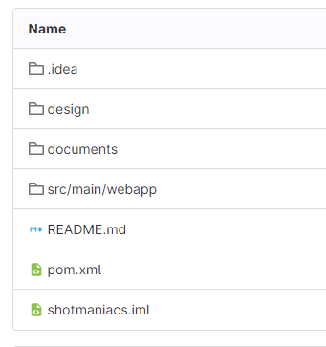
Gitlab
Feature Branching
Protected Main Branch

Slide 6
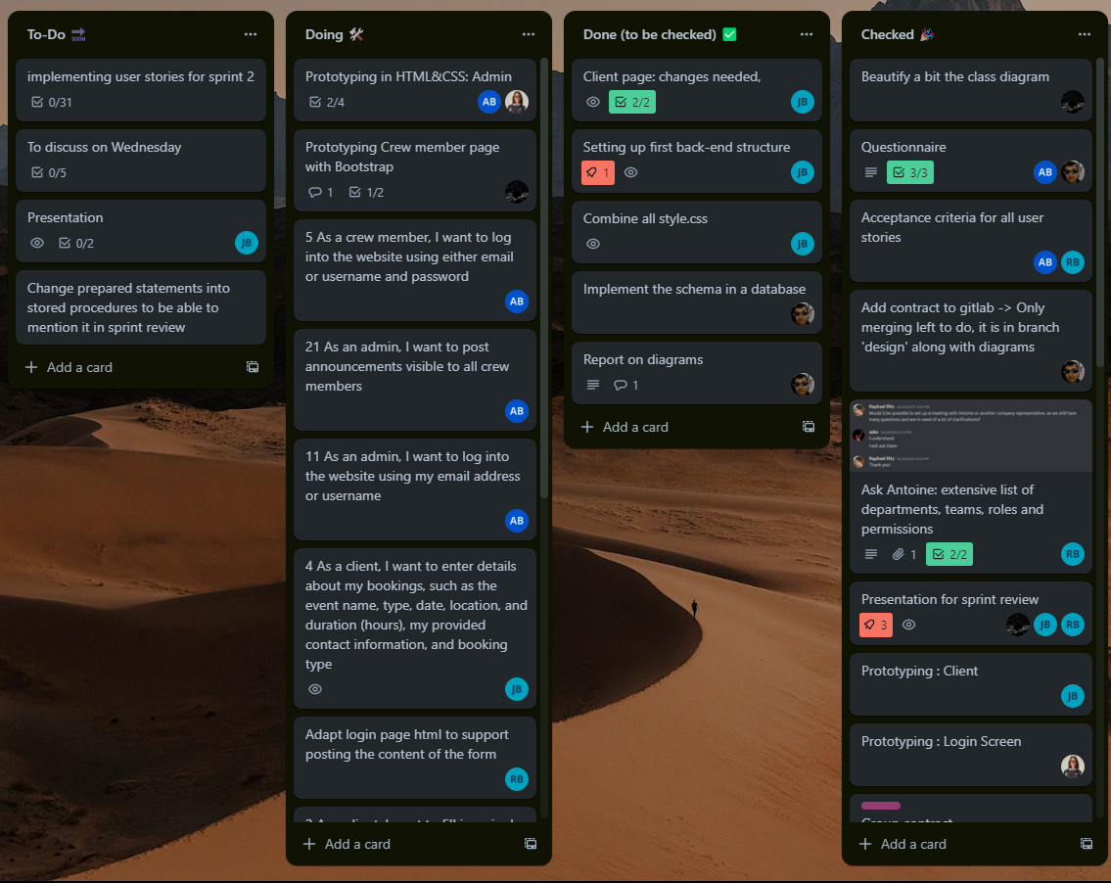
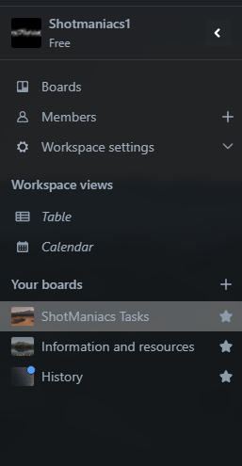
Trello

Slide 7
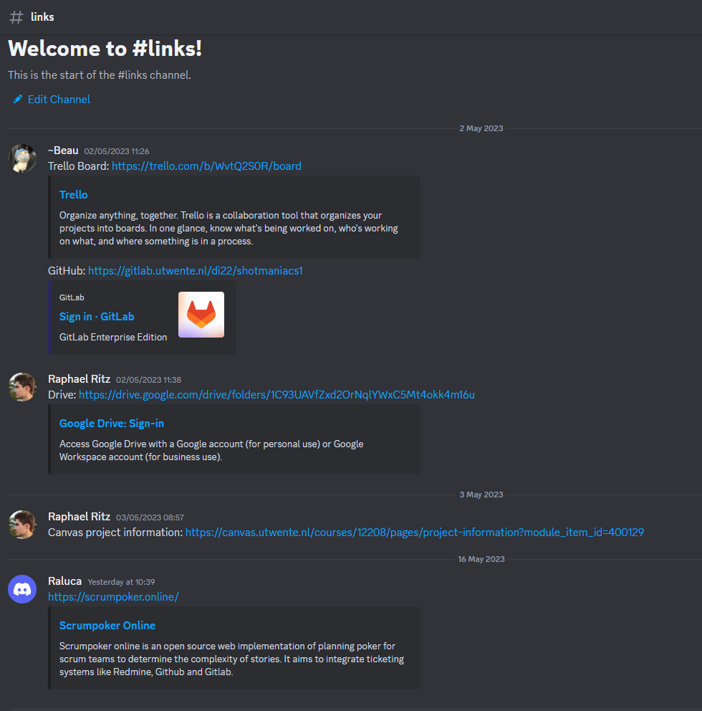
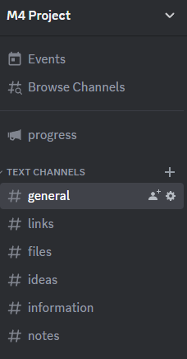
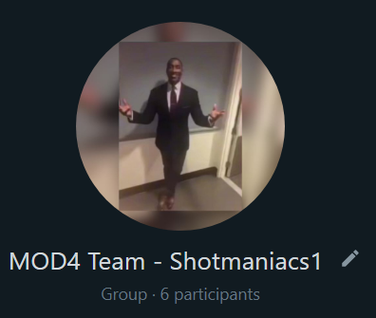
Communication

Slide 8
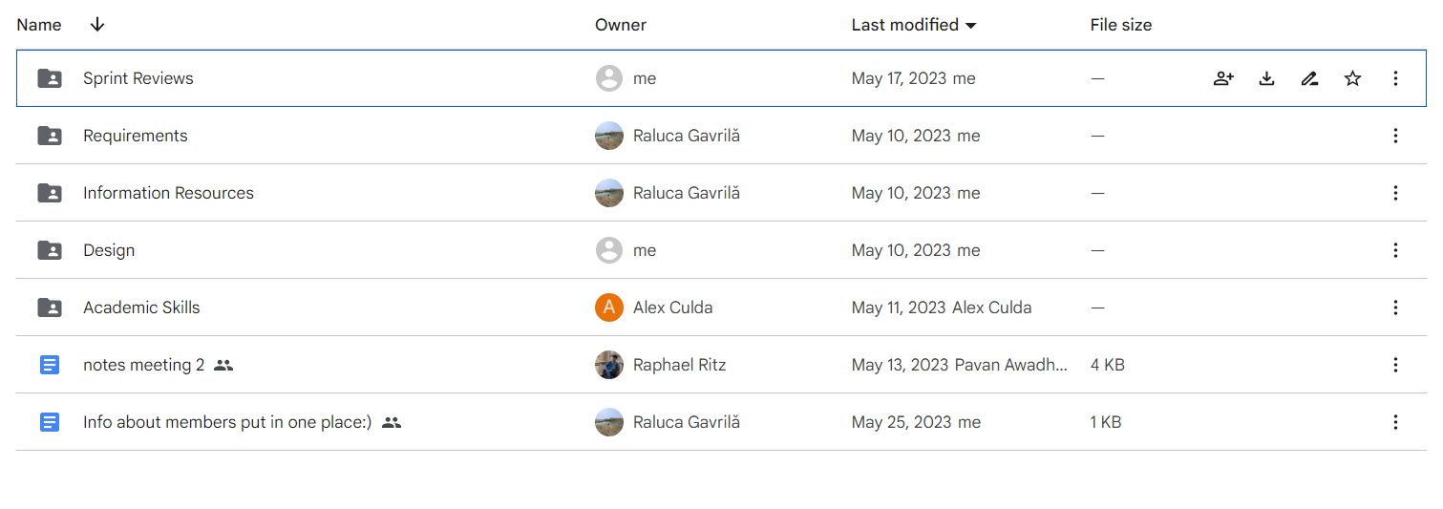
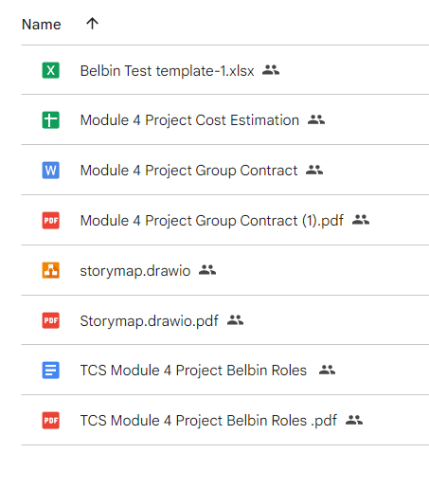
Drive

Slide 9
Planning.

Slide 10
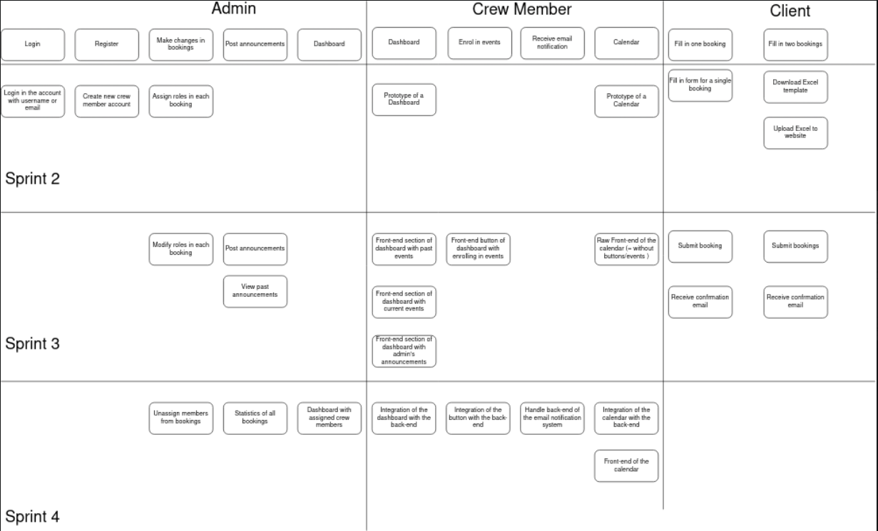
Story
Map

Slide 11
Story
Map

Slide 12
Design.

Slide 13
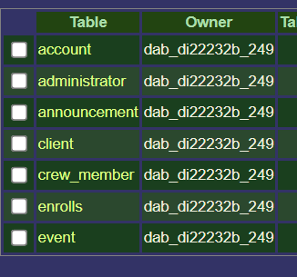
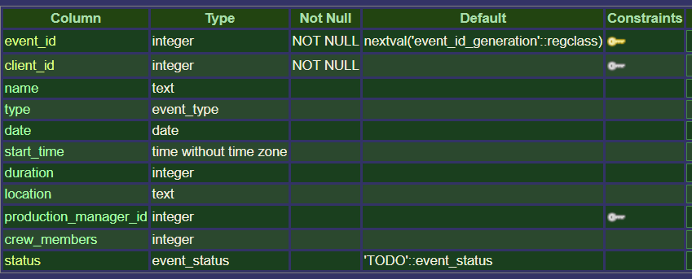
SQL-schema
Constraints
NOT NULL
Foreign key constraint, not always NOT NULL
Default
TODO
nextval(‘sequence’)
Custom Types
Event_type

Slide 14
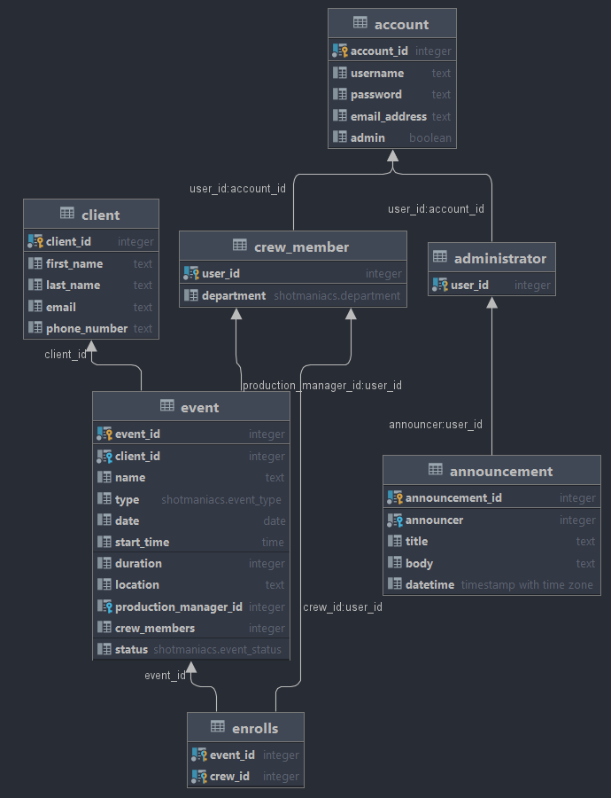
SQL-schema

Slide 15
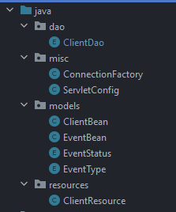
Java class
Design Patterns
Factory Pattern
DAO Pattern
Singleton Pattern
ServletConfig
Init connection on startup tomcat

Slide 16
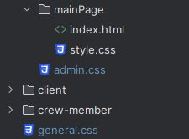
CSS
Structured CSS
mainPage
General
Admin

Slide 17
Security.

Slide 18

Security
Prepared Statements
Hashing and salting/peppering passwords
Roles, through JAX-rs filters.

Slide 19
Testing.

Slide 20

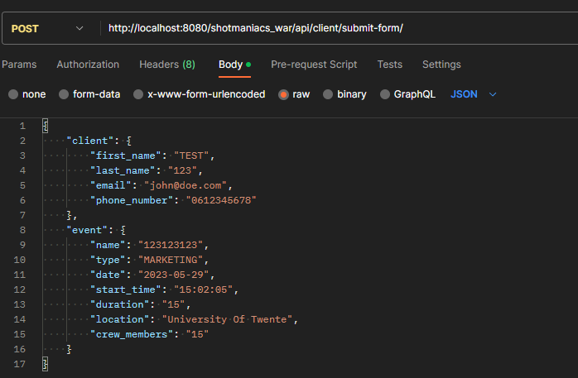
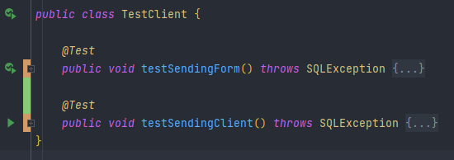
Testing
Postman
jUnit Testing
Application Testing
Test-driven development
Write request before back-end

Slide 21
Progress.

Slide 22
Thank you for listening.
Beau Jonkhout, Pavan Awadhpersad, Baris Yilmaz, Raphael Ritz, Alex Culda, Raluca Gavrila

Slide 23
Questions..?

